Slide 1

Customer Shopping Behaviour Analysis
Uncovering insights from 3,900 purchases to drive strategic decisions

Slide 2
OVERVIEW
Project Scope
Dataset Scale
Analysis Goals
3,900 transactions analyzed across multiple product categories
Spending patterns
Customer segments
Product preferences
Subscription behavior

Slide 3

DATA FOUNDATION
Dataset Overview
18 Columns
3,900 Rows
37 Missing Values
Demographics, purchases, behavior
Complete transaction records
Review ratings only

Slide 4

PYTHON
Data Preparation Process
Key Steps
Imported with pandas
Imputed missing ratings using category medians to maintain data integrity.
Created age_group and purchase_frequency_days
Standardized columns to snake_case
Verified discount_applied and promo_code_used were identical, removed redundant column to streamline dataset
Loaded into PostgreSQL
Explore Structure
Load Data
Inspect columns and types
Import datasets with pandas
Handle Missing
Engineer Features
Create age_group and frequency
Impute using category medians
Remove Redundancy
Verified discount_applied and promo_code_used were identical, removed one column

Slide 5
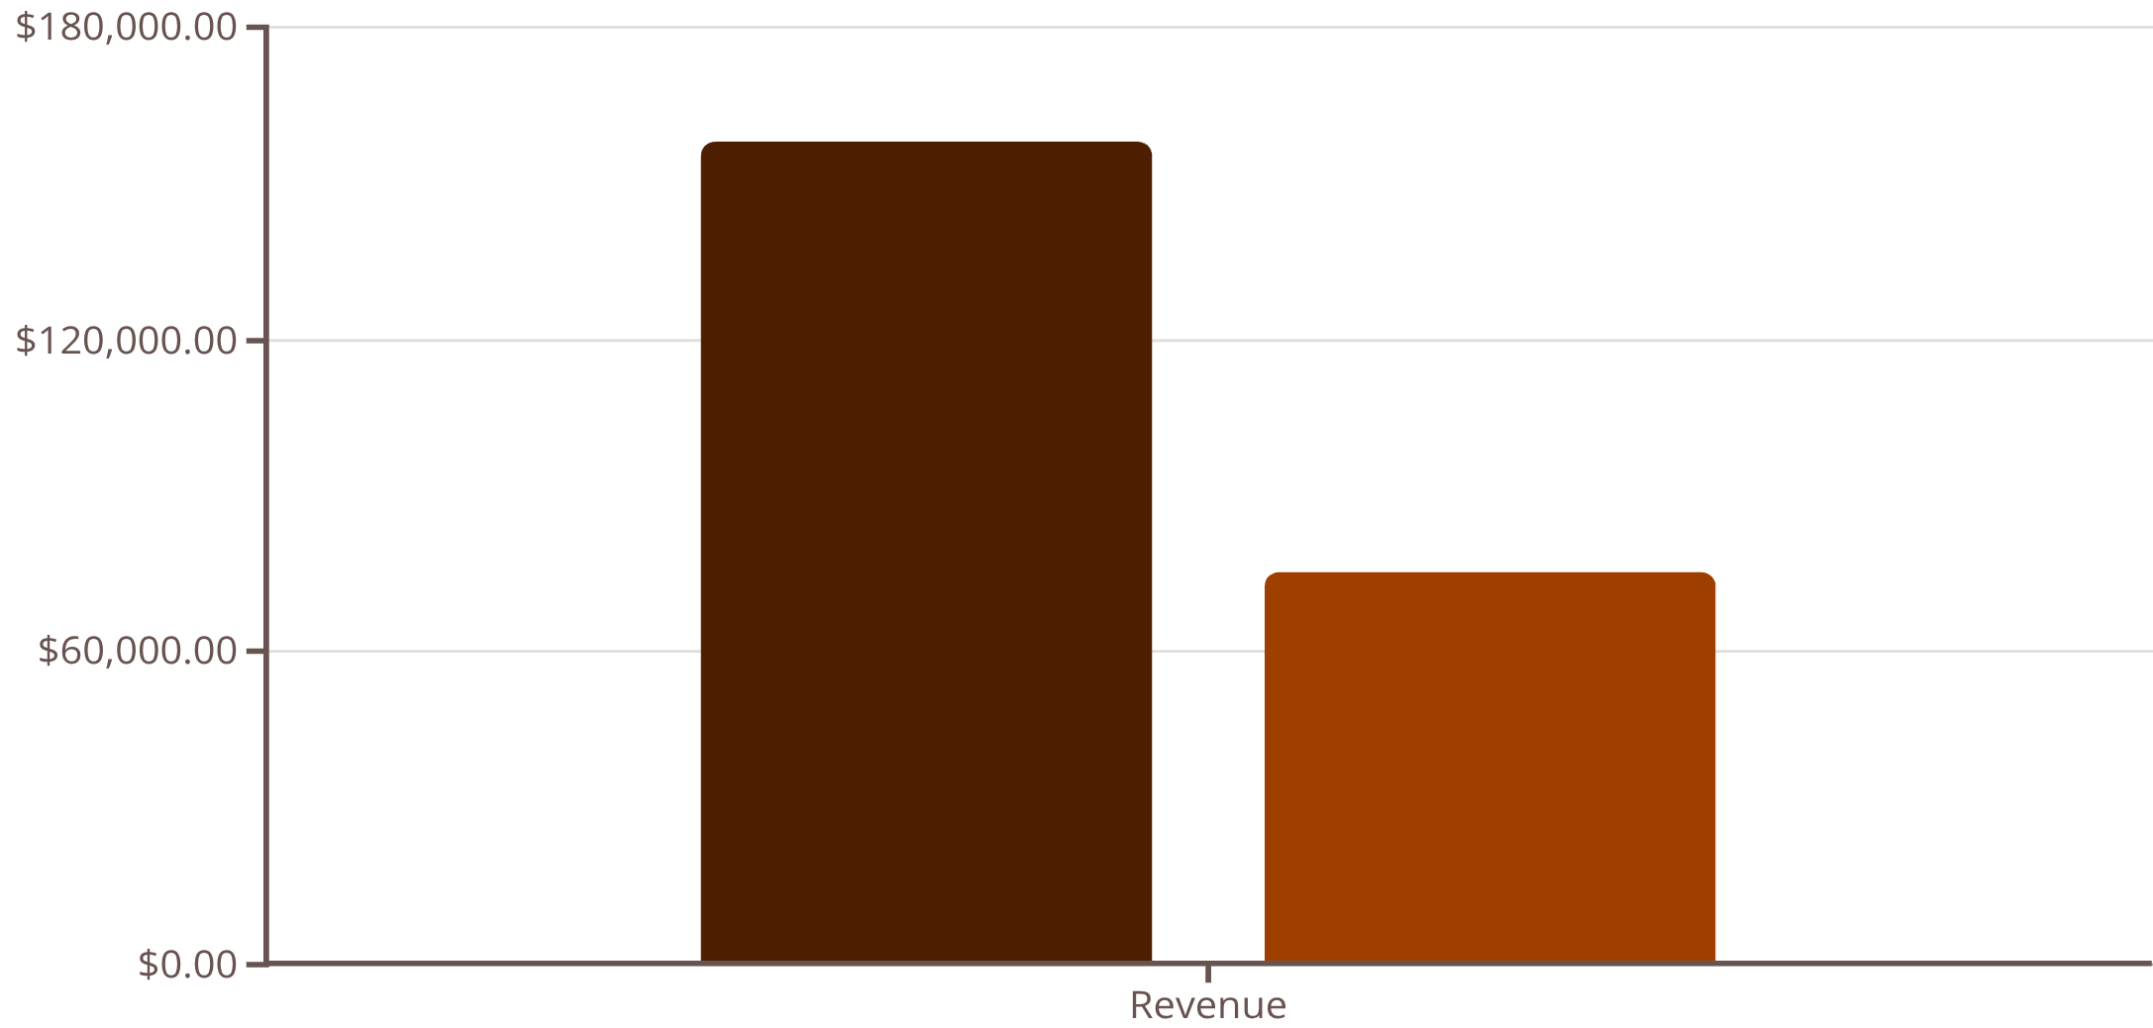
SQL ANALYSIS
Revenue Insights
Gender Comparison
Male customers generated significantly higher revenue ($157,890 vs $75,191), representing a substantial difference in spending patterns across genders.
Shipping Preferences
Express shipping: $60 avg purchase
Standard shipping: $58 avg purchase
Male
Female

Slide 6
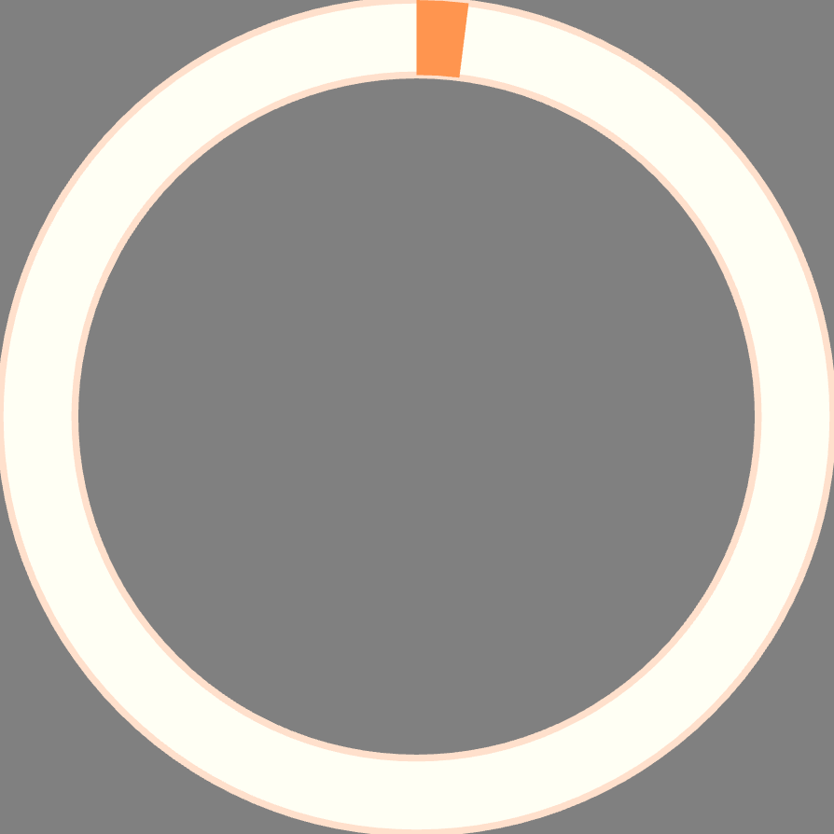
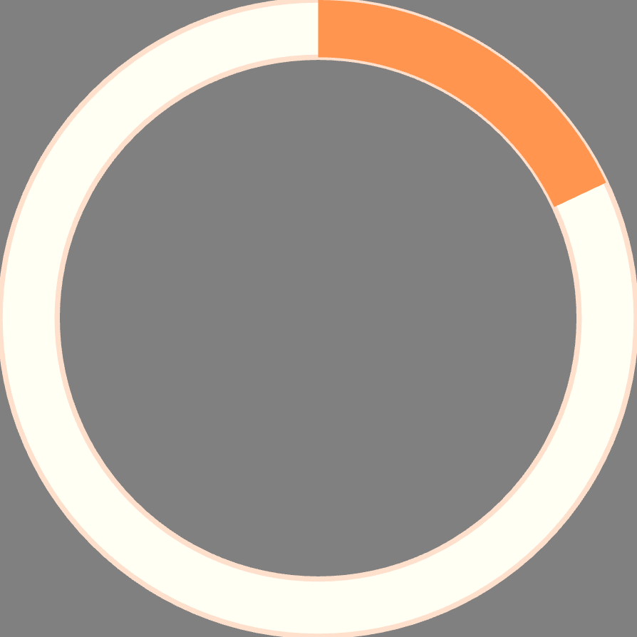
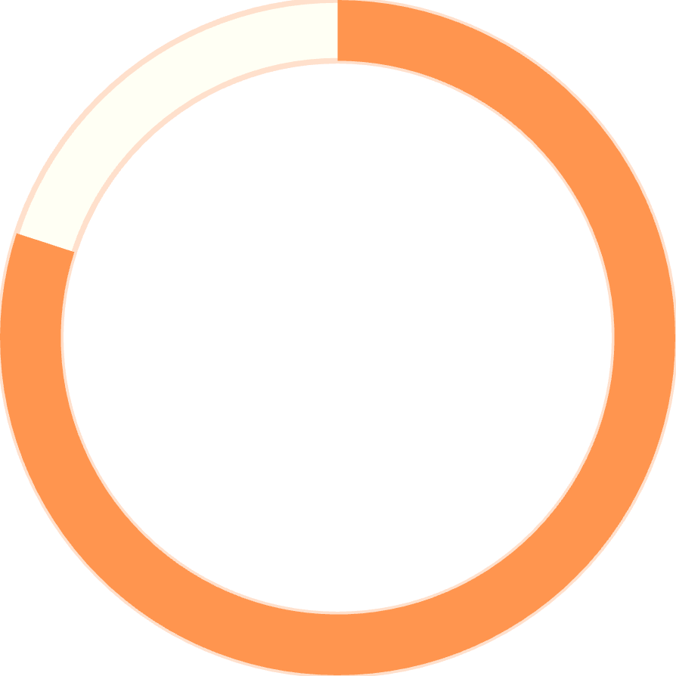
Customer Segmentation
2%
18%
80%
New Customers
Returning
Loyal
83 customers, 1 previous purchase
701 customers, 2-10 previous purchases
3,116 customers, More than 10 previous purchases

Slide 7





PRODUCT PERFORMANCE
Top-Rated Products
Gloves
Sandals
Boots
Hat
3.86 rating
3.84 rating
3.82 rating
3.80 rating
Skirt
3.78 rating

Slide 8





PRODUCT PERFORMANCE
Seasonal Product Trends
Fall: Jacket
Spring: Sweater
Summer: Pants
Winter: Sunglasses
54 orders
52 orders
50 orders
52 orders
Seasonal preferences drive product demand, with Fall jackets leading at 54 orders. Strategic inventory planning aligned with seasonal trends can optimize stock levels and maximize revenue.

Slide 9
Subscription Impact
$59.49
$59.87
Subscribers
Non-Subscribers
Average spend per purchase
Average spend per purchase
Key Finding
Out of customers with 5+ previous purchases (total 3,476), 958 are subscribed and 2,518 are not subscribed. This means a 27.5% subscription rate for customers with 5+ purchases vs 72.5% not subscribed.
Customers with 5+ previous purchases show a 27.5% subscription rate, indicating significant opportunity for subscription growth among repeat buyers

Slide 10
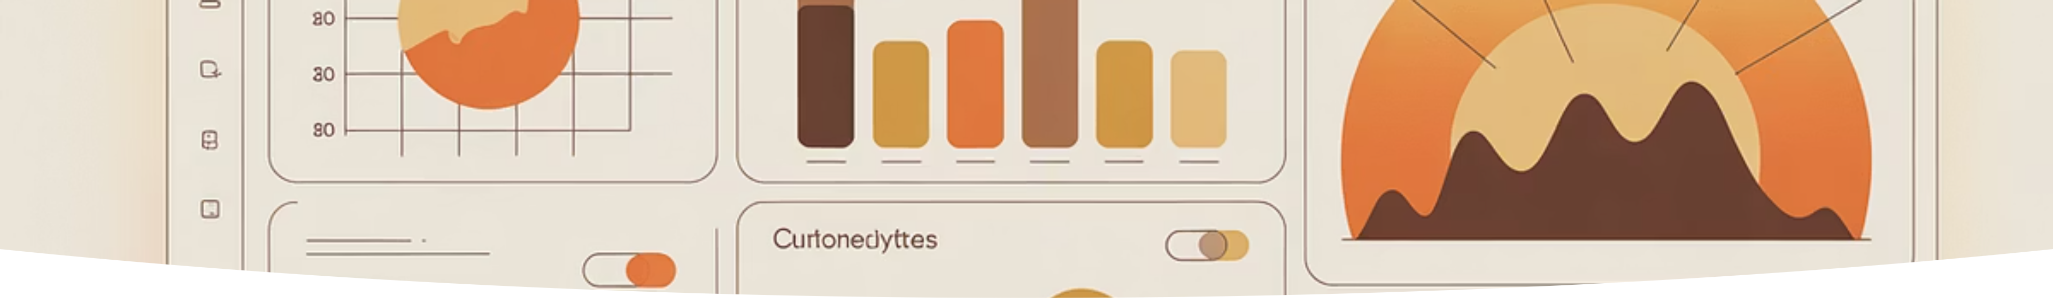
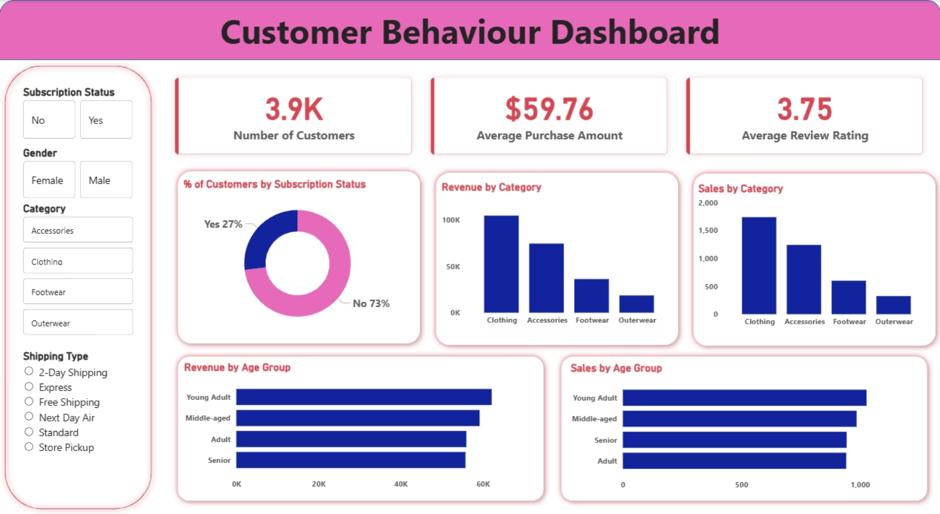
DASHBOARD
Power BI Visualization
Interactive dashboard presenting spending patterns, customer segments, and product performance insights

Slide 11
ACTION PLAN
Strategic Recommendations
1
Boost Subscriptions
Promote exclusive benefits for subscribers
2
Loyalty Programs
Reward repeat buyers to build loyal segment
3
Discount Policy
Balance sales boosts with margin control
4
Product Positioning
Highlight top-rated items in campaigns
5
Seasonal Optimization
Optimize inventory around best-sellers
6
Target Marketing
Focus on high-revenue age groups

